Slide 1

Increasing Pens and Partners’ Sales & Revenue
By Alex Dubro

Slide 2
Business Goals
Founded in 1984, Pens and Partners is an office product provider committed to high quality service for its clients.
~40 years have elapsed since its founding, so the marketing team must identify the most effective, efficient sales method:
Email – email after product launch; follow-up after 3 weeks
Call – call a customer; speak ~30 mins.
Email and Call – received email regarding product, with follow-up call 1 week later
Which will drive sales and increase revenue?
Notes:
Office products -- notebooks, pens and sticky notes
Email – email after product launch; follow-up after 3 weeks
Call – call a customer, with a typical phone call lasting around 30 mins.
Email and Call --

Slide 3
What Do We Want to Know?
How many customers use each sales method?
What’s the breakdown of each sales method according to where the order is shipped to (state) and how long the customer has used company’s services (years as customer)?
How much revenue was earned by each sales method, and how much was earned by each sales method. How does years as customer influence revenue for each sales method, too?
How have sales and revenue changed over time for each sales method?

Slide 4
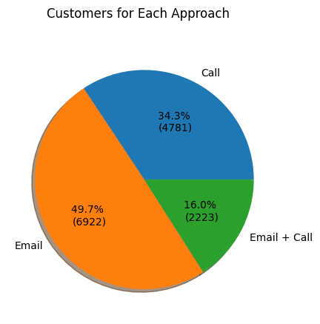
Customer Use (1): Which Sales Method Is Used?
Email: ~50%
Phone: ~34%
Email and call: ~16%
Is email the preferred sales method?

Slide 5
Customer Use (2): How Do State & Years as Customer Influence Sales Method?
State: Each group of sales method have their order shipped to a relatively select number of states: California, Illinois, Pennsylvania, and New York.
Years as customer: Each group of sales method have mostly used the company's services for a relatively short period of time.
No value indicated one sales method is preferred over another.
Notes:
State: 1 year as a customer makes up the highest proportion of customers for each group. Thereafter, the proportion of customers having used the services for more than 1 years decreases linearly.
Years as customer: Notable states had each sales method’s proportion as greater than 4% of the total group's customers.

Slide 6
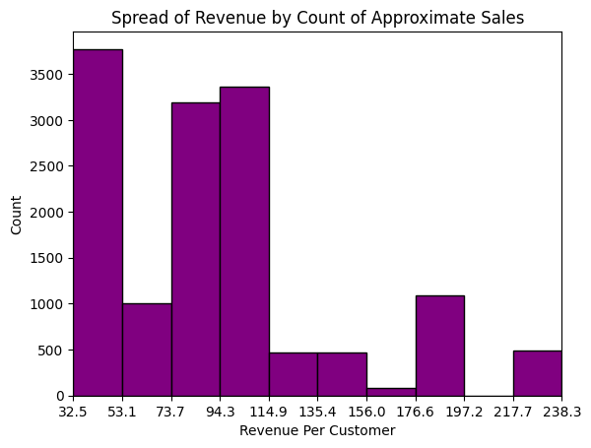
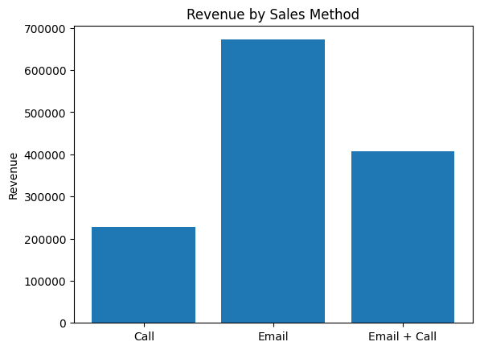
Revenue Analysis (1): Spread & Breakdown by Sales Method
Customers spent between $32 and $53, is ~1-2 purchases.
Sales came predominantly from email, almost double email and call.

Slide 7
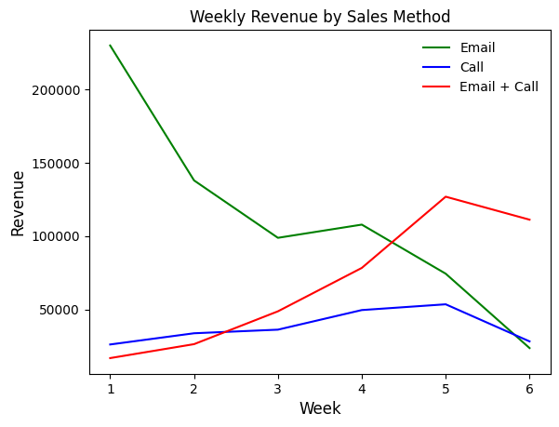
Revenue Analysis (2): Weekly Revenue by Sales Method
Notes:
As the weeks went on, revenue decreased for email. For call, weekly revenue was usually below &dollar;50000, though for week 5, it hit &dollar;53518.11. Revenue by email and call increased over this time period.

Slide 8
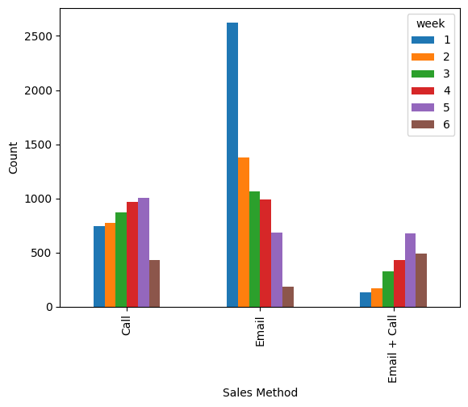
Revenue Analysis (3): Weekly Sales by Sales Method
Notes:
Digging deeper, I found that aggregate revenue and sales decreased over the weeks. **In other words, do not let the weekly revenue graph deceive you into thinking that one sales method is preferred over another.**
Sales decreased since week 1, from 3497 in week 1 to 1096 in week 6, and revenue decreased, too, from &dollar;272,810 in week 1 to &dollar;163,112 in week 6.

Slide 9
Business Metrics & Recommendations
Goal: Increase sales and revenue efficiently.
Metrics
(1) revenue changes over time as (2) each sales method's use changes while (3) accounting for changes in sales.
Sales and revenue have decreased: 69% (from 3,497 to 1,096) and 40% ($272,810 to $163,112), respectively.
Recommendations
Improve data analysis pipeline to create efficient and seamless way to implement the key performance metrics (KPMs).
Implement KPMs ASAP to measure if company is decreasing in profitability and cash flow and at risk of bankruptcy.
Redesign email and call to maintain existing customers as well as bring in new customers.
Benchmark against peers to understand what tools work best and reconstruct existing sales methods.
Change what data is collected, considering that much used did not provide useful, conclusive results.

